Slide 1
SOLUTION
TYPES
GASEOUS SOLUTION
LIQID SLUTION , SOLID SOLUTION

Slide 2
EXPRESSING THE CONCENTRATION OF SOLUTION
MASS PERCENTAGE
VOLUME PERCENTAGE
PART PER MILLION

Slide 3
MOLARITY
Calculation of molar mass of the solute
Find no of moles of solute ( amount of solute /molar mass)
Calculate the volume of solution in litre
Molarity = no. of moles of solute /volume of solution in litre
It is expressed by ‘M’.

Slide 4
MOLALITY
Finding the no. of moles of solute
Calculate the amount of solvent (mass of solution – mass of solute) in kilogram
Molality = no. of moles of solute/mass of solvent in kg
It is expressed by ‘m’.

Slide 5
Mole fraction
Mole fraction of a component =
No. of moles of a component / Total no. of moles of all the components
In a binary solution if the no. of moles of A and B are n_{A} and n_{B} , then mole fraction of A ,
n_{A}/n_{A} + n_{B}
The sum of mole fraction of all the components in a solution is unity .

Slide 6
Numericals
Calculate the molarity of a solution containing 5g of NaOH in 450 mL of solution.
Calculate molality of 2.5 g of ethanoic acid in 75 g of benzene .
Concentrated nitric acid used in laboratory work is 68% nitric acid by mass in aqueous solution. What should be the molarity of such a sample of the acid if the density of the solution is 1.504 gram per mililitre.

Slide 7
Henry’s law
The solubility of a gas at a given temperature is directly proportional to the pressure at which it is dissolved .
p= K_{H} x where K_{H} is Henry’s constant and x is mole fraction of the gas .
The unit of Henry’s constant is torr.
This helps in calculation of solubility at a certain temperature .

Slide 8
Factors afecting solubilty of solids
Nature of solute:-Like Dissolves like . Eg polar solutes dissolves in polar solvents and non- polar solutes dissolve in in non- polar solvents .
Temperature:- The solubility may increase or dicrease with the rise in temperature depending upon the value of enthalpy of solution .

Slide 9
Factors affecting the solubility of gas
The nature of gas and the nature of solvent
Non- polar gases like Oxygen , Nitrogen etc are very less soluble in water , Whereas HCl, Carbon dioxide are highly soluble in water.
Effect of temperature
Effect of pressure

Slide 10
Raoult’s law
The vapor pressure of a a solution containing non- volatile solute is directly proportional to the mole – fraction of the solvent .
For a solution containing non- volatile solute , at a given temperature , the relative lowering of vapour pressure is equal to the mole fraction of the solute .

Slide 11
Ideal and Non- ideal solution
The solution which obeys Raoult’s law over the entire range of concentration and temperature is known as ideal solution and reverse is true for a non- ideal solution .
For ideal solution
(I) it should obey Raoult law, i.e,
(ii) ∆H_{mixing} = 0
(iii) ∆V_{mixing} = 0

Slide 12
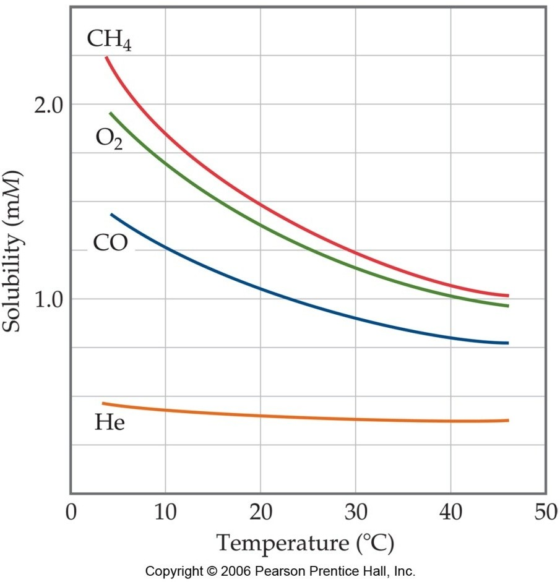
Solubility of Gases
This graph shows how gases decrease in solubility as temperature increases.

Slide 13
Freezing Point Lowering
When a solute is added to a solvent, the freezing point of the solution is lower than that of the pure solvent.
Equation for freezing point depression:
  ΔT_{f} = K_{f} •m
    ΔT_{f} = change in freezing point
    K_{f} = freezing point constant
    m = molality of the solution

Slide 14
Boiling Point Elevation
When a solute is added to a solvent, the boiling point of the solution is higher than that of the pure solvent
Equation for boiling point elevation
  ΔT_{b} = K_{b} •m
    ΔT_{b} = change in boiling point
    K_{b} = boiling point constant
    M = molality of the solution

Slide 15
Osmosis
Semipermeable membranes allow some particles to pass through while blocking others. In biological systems, most semipermeable membranes (such as cell walls) allow water to pass through, but block solutes.
In osmosis, there is net movement of solvent from the area of higher solvent concentration (lower solute concentration) to the are of lower solvent concentration (higher solute concentration.
Water tries to equalize the concentration on both sides until pressure is
too high.

Slide 16

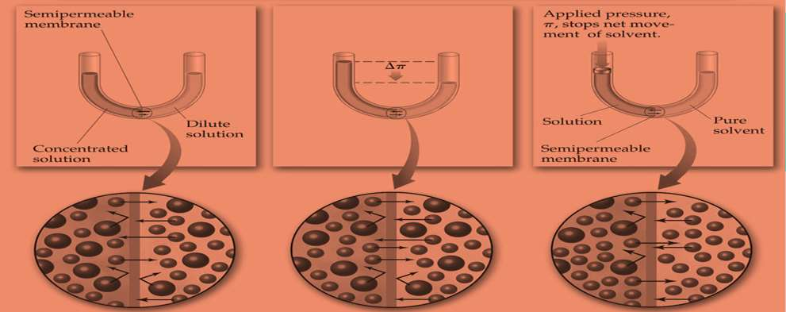
Osmosis

Slide 17
VAN’T - HOFF FACTOR:
One mole of NaCl in water does not really give rise to two moles of ions.
Some Na⁺ and Cl⁻ re associate as hydrated ion pairs, so the true concentration of particles is somewhat less than two times the concentration of NaCl. Some Na⁺ and Cl⁻ re associate as hydrated ion pairs, so the true concentration of particles is somewhat less than two times the concentration of NaCl.

